Slide 1
Autokorelasi Spasial

Slide 2
Korelasi
berat
badan
analisis hubungan antara dua variabel
Koefisien korelasi: besaran yang digunakan untuk menyatakan arah dan keeratan hubungan dua variabel
Kategori besaran nilai korelasi:
0.0 – 0.2 : lemah
0.2 – 0.5 : sedang
0.5 – 0.8 : kuat
0.8 – 1.0 : sangat kuat
tinggi badan
suhu rata-rata
ketinggian tempat

Slide 3
Autokorelasi
korelasi suatu variabel dengan dirinya sendiri
Data deret waktu:
Temperatur hari ini berkorelasi dengan temperature kemarin
Tingkat penjualan bulan ini berkorelasi dengan penjualan bulan lalu
Spasial:
Tingkat kesuburan tanah di suatu titik berkorelasi dengan tingkat kesuburan tanah di sekitarnya
Perekonomian suatu desa berkorelasi dengan perekonomian desa-desa di sekelilingnya

Slide 4
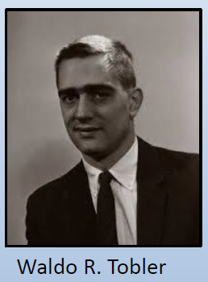
Tobler’s 1st Law of Geography: “Everything is related to everything else, but near things are more related than distant things.” (Tobler W., 1970. A computer movie simulating urban growth in the Detroit region. Economic Geography, 46(2): 234-240)

Slide 5
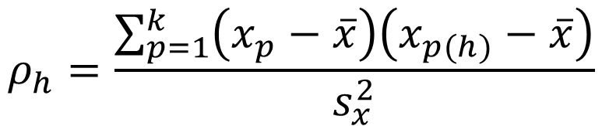
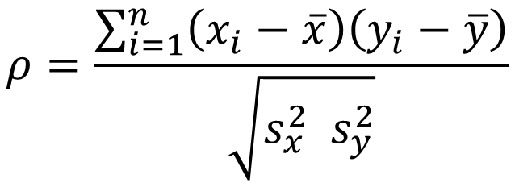
Bagaimana mengukur autokorelasi spasial
Korelasi spasial variabel X pada jarak h
Korelasi antara X dan Y
$$ρ=\frac{\sum_{i=1}^{n}{\left(x_{i}−\overline{x}\right)\left(y_{i}−\overline{y}\right)}}{\sqrt{s_{x}^{2}{ s}_{y}^{2}}}$$
$$ρ_{h}=\frac{\sum_{p=1}^{k}{\left(x_{p}−\overline{x}\right)\left(x_{p(h)}−\overline{x}\right)}}{s_{x}^{2}}$$

Slide 6
Bagaimana mengukur autokorelasi spasial
Korelasi antara X dan Y
Korelasi spasial variabel X pada jarak h
Identifikasi pasangan yang lokasinya berjarak sejauh h
i | X | Y
1 | X₁ | Y₁
2 | X₂ | Y₂
3 | X₃ | Y₃
…
…
…
n | X_{n} | Y_{n}
i | Long | Lat | X
1 |  |  | X₁
2 |  |  | X₂
3 |  |  | X₃
…
…
…
n |  |  | X_{n}
p | X_{p} | X_{p(h)}
1 | X₁ | X_{1(h)}
2 | X₂ | X_{2(h)}
3 | X₃ | X_{3(h)}
…
…
…
k | X_{k} | X_{k(h)}

Slide 7
Ilustrasi
long <- seq(-5,5, by=0.8)
lat <- seq(-5,5, by=0.8)
hasil = NULL
for (i in long){
for (j in lat){
y = (i**2+j**2) + rnorm(1,0,1)
hasil = rbind(hasil,c(i, j, y))
}
}

Slide 8
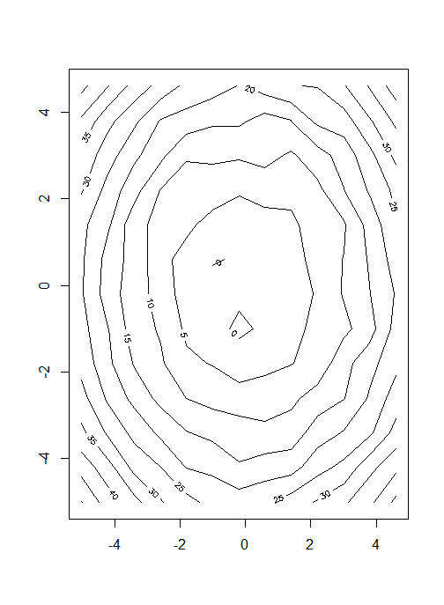
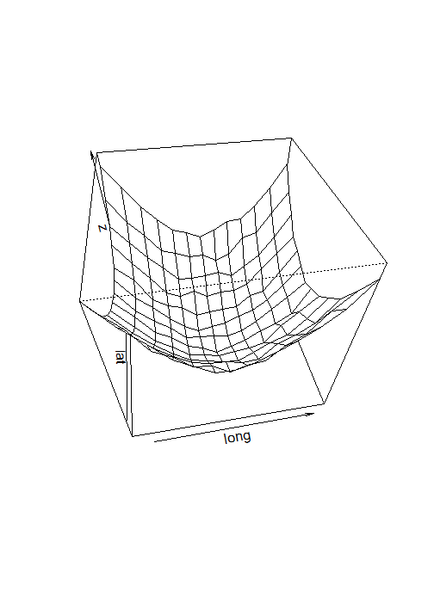
Ilustrasi
z <- matrix(hasil[,3], length(long), length(lat), byrow=TRUE)
persp(long, lat, z, phi=45, theta=-10)
contour(long, lat, z)

Slide 9
Ilustrasi
pasangan = NULL
for (i in 1:(nrow(hasil)-1)){
for (j in (i+1):nrow(hasil)){
jarak = sqrt((hasil[i,1]-hasil[j,1])^2
+ (hasil[i,2]-hasil[j,2])^2)
pasangan = rbind(pasangan, c(i, j, jarak, hasil[i,3],hasil[j,3]))
}
}

Slide 10
Ilustrasi
korelasi <- NULL
for (i in 1:20/2){
pasangan.h <- pasangan[which(pasangan[,3]>=(i-0.5) & pasangan[,3]<i),]
korelasi <- rbind(korelasi, cor(pasangan.h[,4:5])[2])
}
plot(1:20/2, korelasi, type='b', xlab="jarak")

Slide 11
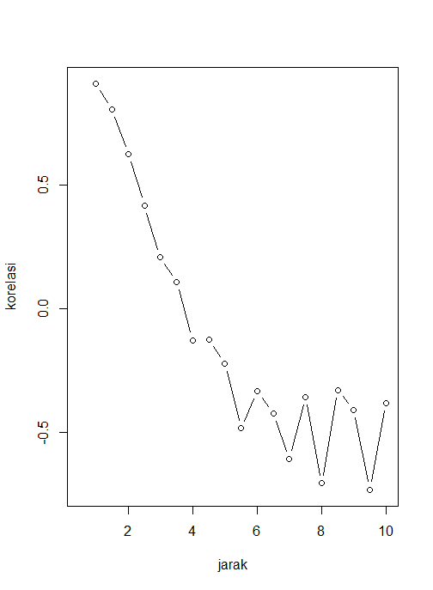

Slide 12
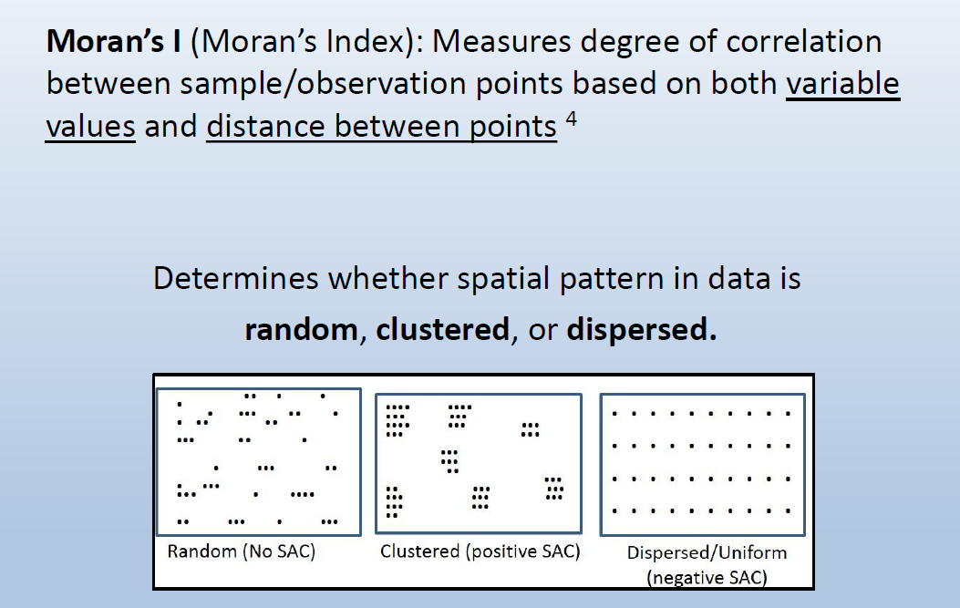

Slide 13
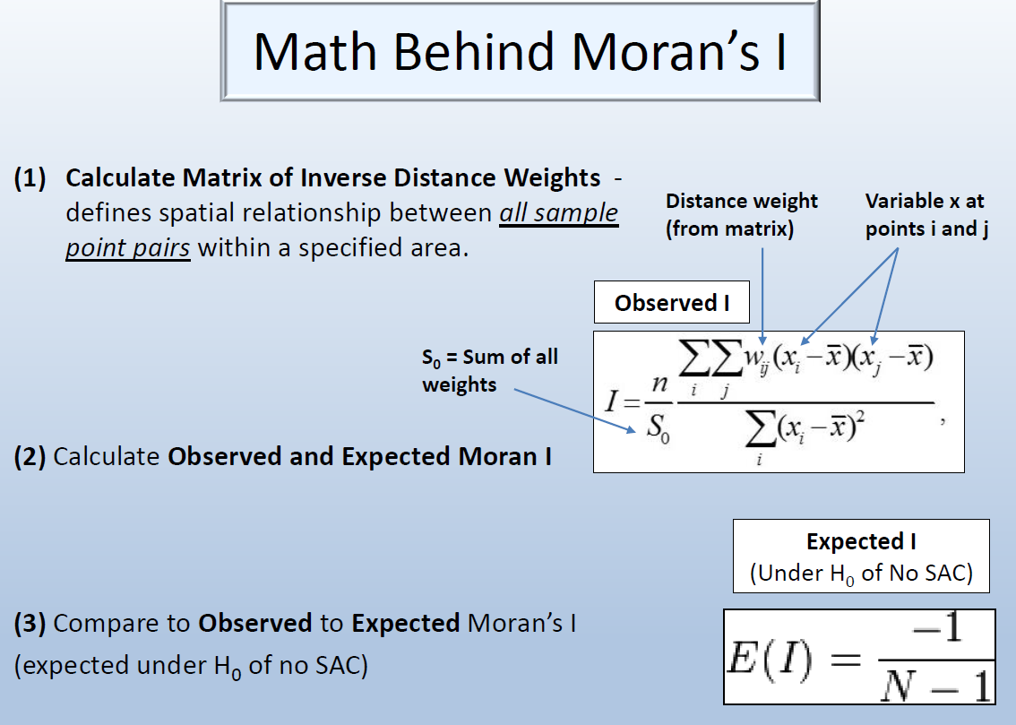

Slide 14
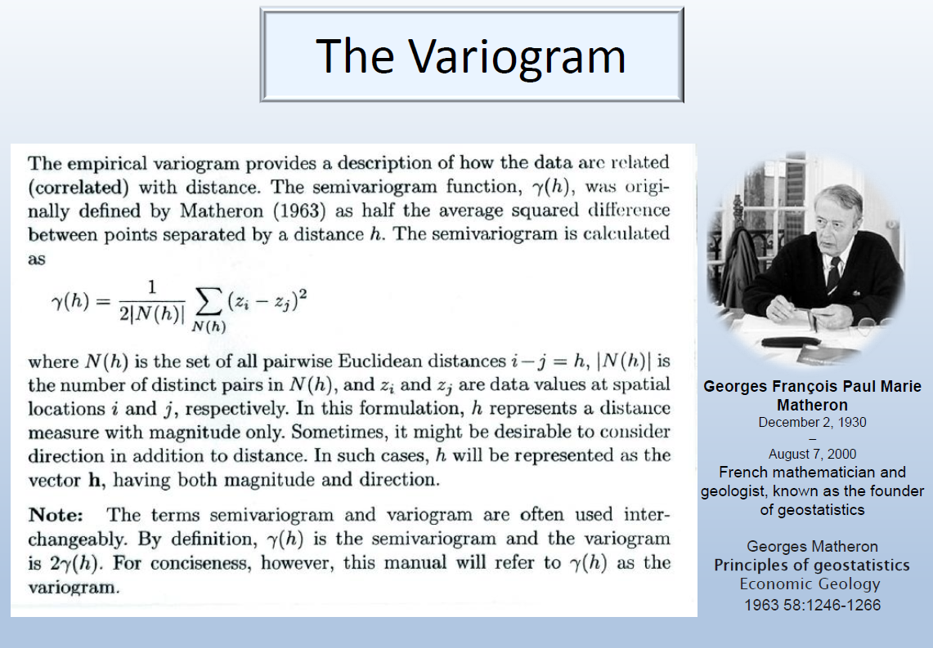

Slide 15
Semivariance
Merupakan salah satu besaran yang dapat digunakan untuk melihat keterkaitan spasial dari sebuah variabel
Jika korelasi spasial digunakan untuk mengukur kemiripan nilai variabel, semivariance digunakan untuk melihat ketidakmiripan.
Secara hipotetik, nilai semivariance diasumsikan semakin besar untuk jarak yang semakin jauh.

Slide 16

Semivariance
u : vektor koordinat spasial yang menyatakan lokasi
z(u) : nilai variabel kajian pada lokasi
h : vektor lag jarak, yaitu jarak tertentu dari suatu lokasi
z(u+h): nilai variabel kajian pada lokasi dengan jarak tertentu dari u

Slide 17
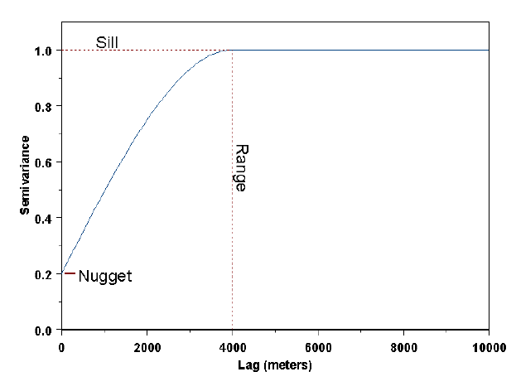
Variogram plot nilai semivariance pada berbagai jarak

Slide 18
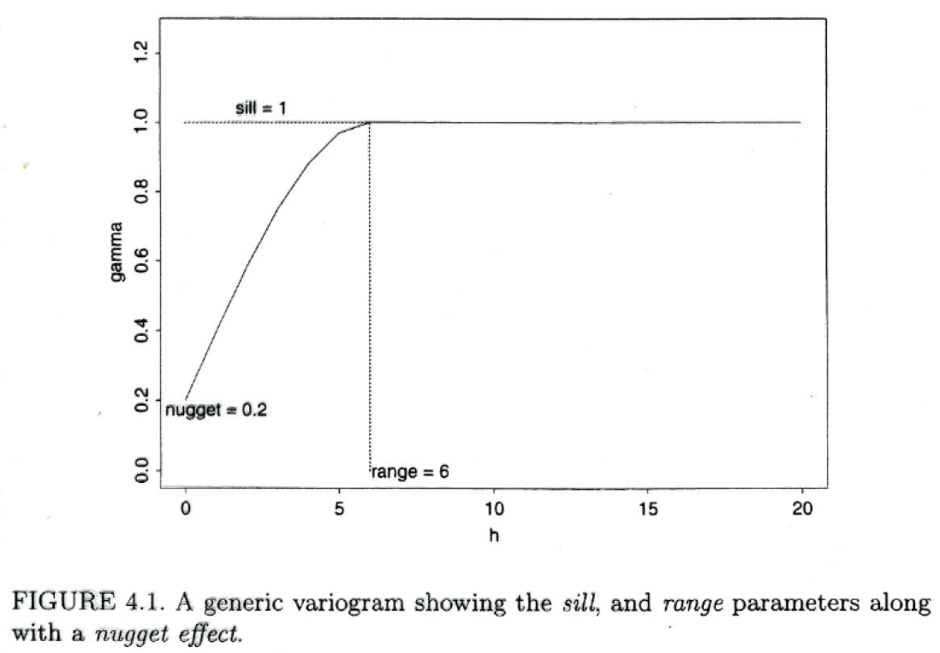
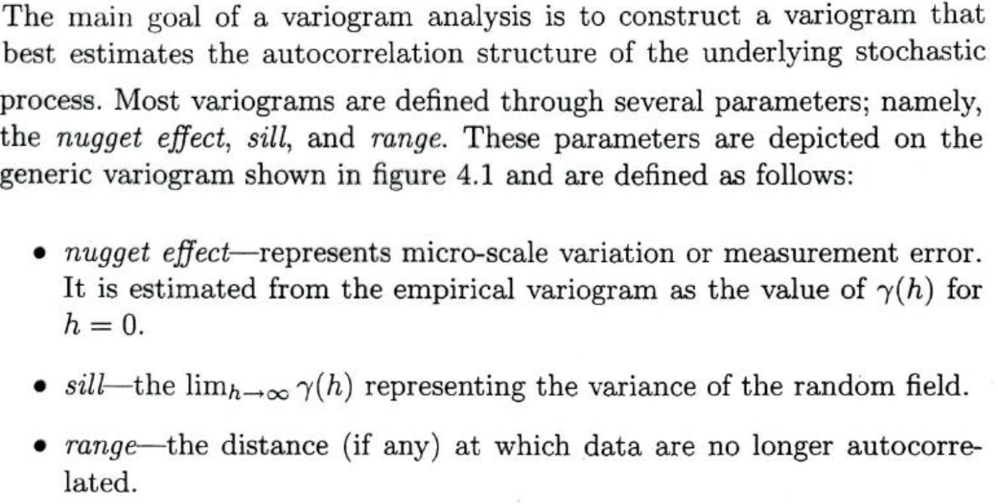

Slide 19
Characteristics of Variogram
Sill: The semivariance value at which the variogram levels off. Also used to refer to the “amplitude” of a certain component of the semivariogram.
Range: The lag distance at which the semivariogram (or semivariogram component) reaches the sill value. Presumably, autocorrelation is essentially zero beyond the range.
Nugget: In theory the semivariogram value at the origin (0 lag) should be zero. If it is significantly different from zero for lags very close to zero, then this semivariogram value is referred to as the nugget. The nugget represents variability at distances smaller than the typical sample spacing, including measurement error.

Slide 20
Spatial Independence at Small Distances
Even though we assume that values at points that are very near each other are correlated, points that are separated by very, very small values might be considerably less correlated
E.g.: you might find a gold nugget and no more gold in the vicinity
In other words, even though γ(0) is always 0, however γ at very, very small distances will be equal to a value a that is considerably greater than 0.
This value denoted by a is called the nugget
The ratio of the nugget to the sill is known as the nugget effect, and may be interpreted as the percentage of variation in the data that is not spatial
The difference between the sill and the nugget is known as the partial sill
The partial sill, and not the sill itself, is reported in GeoStatistical Analyst

Slide 21
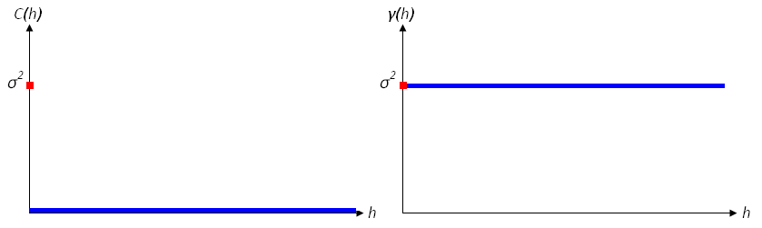
Pure Nugget Effect Variograms
Pure nugget effect is when the covariance between point values is zero at all distances h
That is, there is absolutely no spatial autocorrelation in the data (even at small distances)
Pure nugget effect covariogram and variogram are presented below
Interpolation won’t give a reasonable predictions
Most cases are not as extreme and have both a spatially dependent and a spatially independent component, regardless of variogram model chosen (discussed on following slides)

Slide 22
Modeling Variogram
For the sake of kriging (or stochastic simulation), we need to replace the empirical semivariogram with an acceptable semivariogram model.
Part of the reason for this is that the kriging algorithm will need access to semivariogram values for lag distances other than those used in the empirical semivariogram.
More importantly, the semivariogram models used in the kriging process need to obey certain numerical properties in order for the kriging equations to be solvable. (Technically, the semivariogram model needs to be non-negative definite, in order the system of kriging equations to be non-singular).
Therefore, geostatisticians choose from a palette of acceptable semivariogram models.

Slide 23
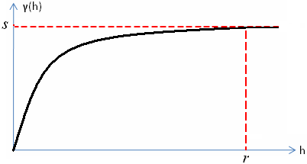
The Spherical Model
The spherical model is the most widely used variogram model
Monotonically non-decreasing
I.e., as h increases, the value of γ(h) does not decrease - i.e., it goes up (until h≤r) or stays the same (h>r)
γ(h≥r)=s and C(h≥r)=0
That is, covariance is assumed to be exactly zero at distances h≥r

Slide 24
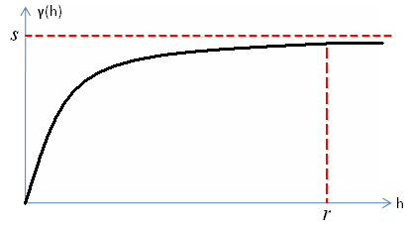
The Exponential Model
The exponential variogram looks very similar to the spherical model, but assumes that the correlation never reaches exactly zero, regardless of how great the distances between points are
In other words, the variogram approaches the value of the sill asymptotically
Because the sill is never actually reached, the range is generally considered to be the smallest distance after which the covariance is 5% or less of the maximum covariance
The model is monotonically increasing
I.e., as h goes up, so does γ(h)

Slide 25
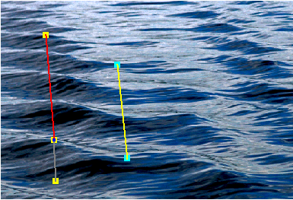
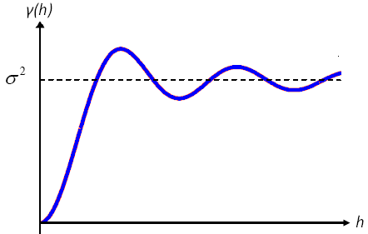
The Wave (AKA Hole-Effect) Model
On the picture to the left, the waves exhibit a periodic pattern. A non-standard form of spatial autocorrelation applies. Peaks are similar in values to other peaks, and troughs are similar in values to other troughs. However, note the dampening in the covariogram and variogram below: That is, peaks that are closer together have values that are more correlated than peaks that are father apart (and same holds for troughs).
More is said about the applicability of these models in ttp://www.gaa.org.au/pdf/gaa_pyrcz_deutsch.pdf
Variogram graph edited slightly from: http://www.seas.upenn.edu/~ese502/NOTEBOOK/Part_II/4_Variograms.pdf

Slide 26
Variogram models
There are two reasons we need to fit a model to the empirical variogram:
Spatial prediction (kriging) requires estimates of the variogram γ(h) for those h’s which are not available in the data.
The empirical variogram cannot guarantee the variance of predicted values to be positive. A variogram model can ensure the variance positive.
Various parametric variogram models have been used in the literature. The follows are some of the most popular ones.
Linear model –
where c₀ is the nugget effect. The linear variogram
has no sill, and so the variance of the process is infinite.
The existence of a linear variogram suggests a trend in
the data, so you should consider fitting a trend to the
data, modeling the data as a function of the coordinates (trend surface analysis).
γ(h)
h

Slide 27
Power model -
where c₀ is the nugget effect. The power variogram has no sill, so the variance of the process is infinite. The linear variogram is a special case of the power model. Similarly, the existence of a linear variogram suggests a trend in the data, so you should consider fitting a trend to the data, modeling the data as a function of the coordinates (trend surface analysis).
α > 1
γ(h)
α < 1
h

Slide 28
Exponential model -
where c₀ is the nugget effect. The sill is c₀+c₁. The range for the exponential model is defined to be 3α at which the variogram is of 95% of the sill.
Gaussian model -
where c₀ is the nugget effect. c₀+c₁ is the sill. The range is 3α. This model describes a random field that is considered to be too smooth and possesses the peculiar property that Z(s) can be predicted without error for any s on the plane.
γ(h)
h
γ(h)
h

Slide 29
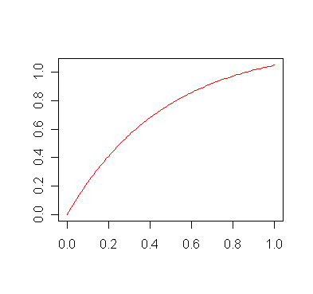
Cauchy model -
where c₀ is the nugget effect is 0. The sill is c₀+c₁.
Matern model -
where c₀ is the nugget effect. The sill is c₀+c₁. Matern model is the default in variog of geoR.
Matern function for c₀=0
γ(h)
Bessel function:
h

Slide 30
Logistic model (rational quadratic model) -
where c₀ is the nugget effect. The sill is c₀+a/b. The range for the logistic model is
Spherical model -
where c₀ is the nugget effect. The sill is c₀+c₁. The range for the spherical model can be computed by setting γ(h) = 0.95(c₀+c₁).
γ(h)
h
for 0 < h ≤ a
for h ≥ a
γ(h)
h

Slide 31
Parameter estimation
There are commonly two ways to fit the variogram models to an empirical variogram. Assume the variogram model γ(h; θ), where θ is an unknown parameter vector. For example, for the exponential variogram model θ = (c₀, c₁, α).
Ordinary least squares method – The OLS estimator for θ is obtained by finding that minimizes
Notes:
OLS estimation assumes that
- does not depend on the lag distance h_{i}
- for all pairs of lag distances h_{i} ≠ h_{i}.
Both assumptions are violated. The variance and the covariance depend on the number of pairs of sites used to compute the empirical variogram (see Cressie 1985).
These violations do not contribute significantly to the bias of the parameter estimation.

Slide 32
Weighted least squares estimator
The WLS estimator for θ is obtained by finding that minimizes
where
So that,
To note that the WLS estimator is more precise (has a smaller variance) than the OLS estimator.
Model selection criteria: Select a model with the smallest residual sum of squares or AIC or log-likelihood ratio, but pay a particularly attention to the goodness-of-fit at short distance lags (important for efficient spatial prediction).

Slide 33
R implementation for fitting variograms
Note: (1) There are many covariance model for choosing: "matern", "exponential", "gaussian", "spherical", "circular", "cubic", "wave", "power", "powered.exponential", "cauchy", "gencauchy", "gneiting", "gneiting.matern", "pure.nugget".
(2) In the function variofit, weis=“equal” (i.e., OLS) each sample equally contributes to the objective function Q(θ), while by the default (i.e., WLS) Q(θ) is weighted in proportion to the number of obs used in computing the sample variance. Thus, locations based on a few obs will not carry as much weight compared to the one based on a large number of obs.
library(geoR)
data.x <- data.frame(hasil)
data.x2 <- as.geodata(data.x, coord.col=1:2, data.col=3)
variog <- variog(data.x2,max.dist=10)
plot(variog, type='b')
variog.ols.exp <- variofit(variog, cov.model="exponential",wei="equal")
plot(variog)
lines(variog.ols.exp)
variog.ols.sph <- variofit(variog, cov.model="spherical",wei="equal")
lines(variog.ols.sph, col="red")

Slide 34
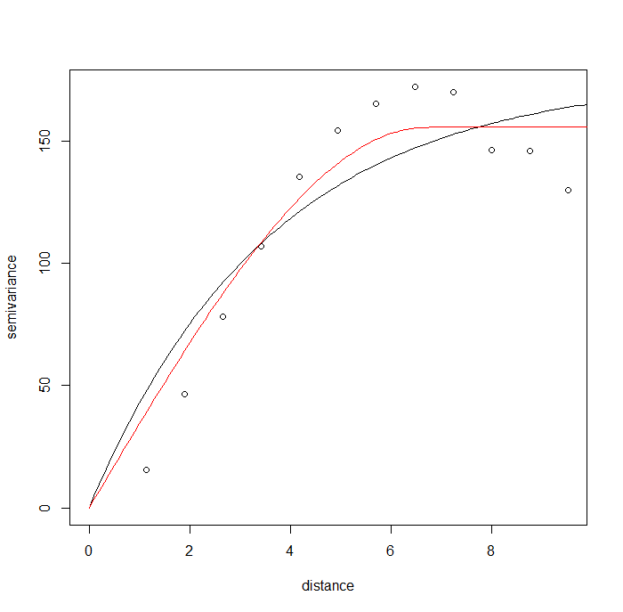

Slide 35
Interpolasi Spasial

Slide 36
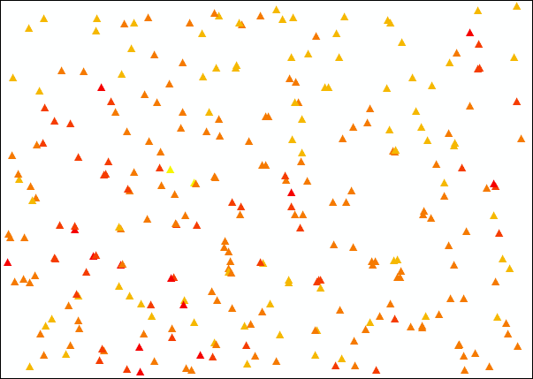
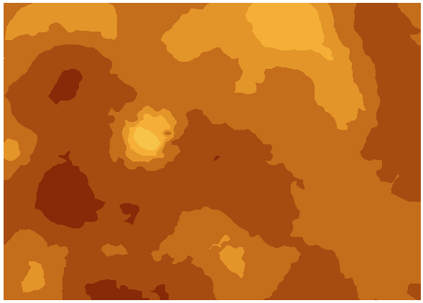
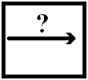
What is Interpolation?
Assume we are dealing with a variable which has meaningful values at every point within a region (e.g., temperature, elevation, concentration of some mineral). Then, given the values of that variable at a set of sample points, we can use an interpolation method to predict values of this variable at every point
For any unknown point, we take some form of weighted average of the values at surrounding points to predict the value at the point where the value is unknown
In other words, we create a continuous surface from a set of points
As an example used throughout this presentation, imagine we have data on the concentration of gold in western Pennsylvania at a set of 200 sample locations:
Input Process Output

Slide 37
Appropriateness of Interpolation
Interpolation should not be used when there isn’t a meaningful value of the variable at every point in space (within the region of interest)
That is, when points represent merely the presence of events (e.g., crime), people, or some physical phenomenon (e.g., volcanoes, buildings), interpolation does not make sense.
Whereas interpolation tries to predict the value of your variable of interest at each point, density analysis (available, for instance, in ArcGIS’s Spatial Analyst) “takes known quantities of some phenomena and spreads it across the landscape based on the quantity that is measured at each location and the spatial relationship of the locations of the measured quantities”.
Source: http://webhelp.esri.com/arcgisdesktop/9.2/index.cfm?TopicName=Understanding_density_analysis

Slide 38
Interpolation vs. Extrapolation
Interpolation is prediction within the range of our data
E.g., having temperature values for a bunch of locations all throughout PA, predict the temperature values at all other locations within PA
Note that the methods we are talking about are strictly those of interpolation, and not extrapolation
Extrapolation is prediction outside the range of our data
E.g., having temperature values for a bunch of locations throughout PA, predict the temperature values in Kazakhstan

Slide 39

First Law of Geography
“Everything is related to everything else, but near things are more related than distant things.”
Waldo Tobler (1970)
This is the basic premise behind interpolation, and near points generally receive higher weights than far away points
Waldo Tobler
Reference: TOBLER, W. R. (1970). "A computer movie simulating urban growth in the Detroit region". Economic Geography, 46(2): 234-240.

Slide 40
Methods of Interpolation
Deterministic methods
Use mathematical functions to calculate the values at unknown locations based either on the degree of similarity (e.g. IDW) or the degree of smoothing (e.g. RBF) in relation with neighboring data points.
Examples include:
Inverse Distance Weighted (IDW)
Radial Basis Functions (RBF)
Geostatistical methods
Use both mathematical and statistical methods to predict values at all locations within region of interest and to provide probabilistic estimates of the quality of the interpolation based on the spatial autocorrelation among data points.
Include a deterministic component and errors (uncertainty of prediction)
Examples include:
Kriging
Co-Kriging
Reference: http://www.crwr.utexas.edu/gis/gishydro04/Introduction/TermProjects/Peralvo.pdf

Slide 41
Exact vs. Inexact Interpolation
Interpolators can be either exact or inexact
At sampled locations, exact interpolators yield values identical to the measurements.
I.e., if the observed temperature in city A is 90 degrees, the point representing city A on the resulting grid will still have the temperature of 90 degrees
At sampled locations, inexact interpolators predict values that are different from the measured values.
I.e., if the observed temperature in city A is 90 degrees, the inexact interpolator will still create a prediction for city A, and this prediction will not be exactly 90 degrees
The resulting surface will not pass through the original point
Can be used to avoid sharp peaks or troughs in the output surface
Model quality can be assessed by the statistics of the differences between predicted and measured values
Jumping ahead, the two deterministic interpolators that will be briefly presented here are exact. Kriging can be exact or inexact.
Reference: Burrough, P. A., and R. A. McDonnell. 1998. Principles of geographical information systems. Oxford University Press, Oxford. 333pp.

Slide 42
Deterministic Interpolation

Slide 43
Inverse Distance Weighted (IDW)
IDW interpolation explicitly relies on the First Law of Geography. To predict a value for any unmeasured location, IDW will use the measured values surrounding the prediction location. Measured values that are nearest to the prediction location will have greater influence (i.e., weight) on the predicted value at that unknown point than those that are farther away.
Thus, IDW assumes that each measured point has a local influence that diminishes with distance (or distance to the power of q > 1), and weighs the points closer to the prediction location greater than those farther away, hence the name inverse distance weighted.
Inverse Squared Distance (i.e., q=2) is a widely used interpolator
For example, ArcGIS allows you to select the value of q.
Weights of each measured point are proportional to the inverse distance raised to the power value q. As a result, as the distance increases, the weights decrease rapidly. How fast the weights decrease is dependent on the value for q.
Source: http://webhelp.esri.com/arcgisdesktop/9.2/index.cfm?TopicName=How_Inverse_Distance_Weighted_(IDW)_interpolation_works

Slide 44
Inverse Distance Weighted - Continued
Because things that are close to one another are more alike than those farther away, as the locations get farther away, the measured values will have little relationship with the value of the prediction location.
To speed up the computation we might only use several points that are the closest
As a result, it is common practice to limit the number of measured values that are used when predicting the unknown value for a location by specifying a search neighborhood. The specified shape of the neighborhood restricts how far and where to look for the measured values to be used in the prediction. Other neighborhood parameters restrict the locations that will be used within that shape.
The output surface is sensitive to clustering and the presence of outliers.

Slide 45
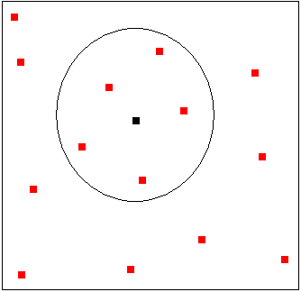
Search Neighborhood Specification
5 nearest neighbors with known values (shown in red) of the unknown point (shown in black) will be used to determine its value
Points with known values of elevation that are outside the circle are just too far from the target point at which the elevation value is unknown, so their weights are pretty much 0.

Slide 46
The Accuracy of the Results
One way to assess the accuracy of the interpolation is known as cross-validation
Remember the initial goal: use all the measured points to create a surface
However, assume we remove one of the measured points from our input, and re-create the surface using all the remaining points.
Now, we can look at the predicted value at that removed point and compare it to the point’s actual value!
We do the same thing for all the points
If the average (squared) difference between the actual value and the prediction is small, then our model is doing a good job at predicting values at unknown points. If this average squared difference is large, then the model isn’t that great. This average squared difference is called mean square error of prediction. For instance, the Geostatistical Analyst of ESRI reports the square root of this average squared difference
Cross-validation is used in other interpolation methods as well

Slide 47
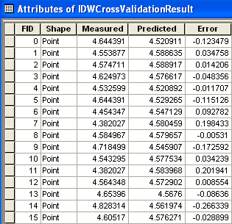
A Cross-Validation Example
Assume you have measurements at 15 data points, from which you want to create a prediction surface
The Measured column tells you the measured value at that point. The Predicted column tells you the prediction at that point when we remove it from the input (i.e., use the other 14 points to create a surface). The Error column is simply the difference between the measured and predicted values.
Because we can have an over-prediction or under-prediction at any point, the error can be positive or negative. So averaging the errors won’t do us much good if we want to see the overall error – we’ll end up with a value that is essentially zero due to these positives and negatives
Thus, in order to assess the extent of error in our prediction, we square each term, and then take the average of these squared errors. This average is called the mean squared error (MSE)
For example, ArcGIS reports the square root of this mean squared error (referred to as simply Root-Mean-Square in Geostatistical Analyst). This root mean square error is often denoted as RMSE.

Slide 48
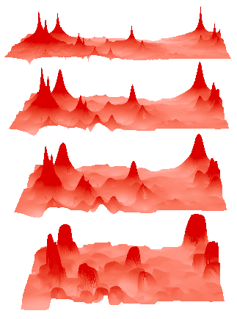
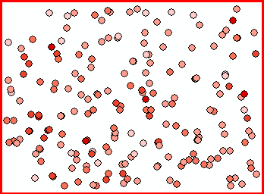
Examples of IDW with Different q’s
q = 1
q=2
q=3
q=10
Gold concentrations at locations in western PA
The Geostatistical Analyst of ArcGIS is able to tell you the optimal value of q by seeing which one yields the minimum RMSE. (Here, it is q=1).
Larger q’s (i.e., power to which distance is raised) yield smoother surfaces
Food for thought: What happens when q is set to 0?

Slide 49
Geostatistical Interpolation

Slide 50

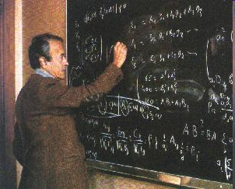
Origins
Involve a set of statistical techniques called Kriging (there are a bunch of different Kriging methods)
Kriging is named after Danie Gerhardus Krige, a South African mining engineer who presented the ideas in his masters thesis in 1951. These ideas were later formalized by a prominent French mathematician Georges Matheron
For more information, see:
Krige, Danie G. (1951). "A statistical approach to some basic mine valuation problems on the Witwatersrand". J. of the Chem., Metal. and Mining Soc. of South Africa 52 (6): 119–139.
Matheron, Georges (1962). Traité de géostatistique appliquée, Editions Technip, France
Kriging has two parts: the quantification of the spatial structure in the data (called variography) and prediction of values at unknown points
Danie Gerhardus Krige
Georges Matheron
Souce of this information: http://en.wikipedia.org/wiki/Daniel_Gerhardus_Krige

Slide 51
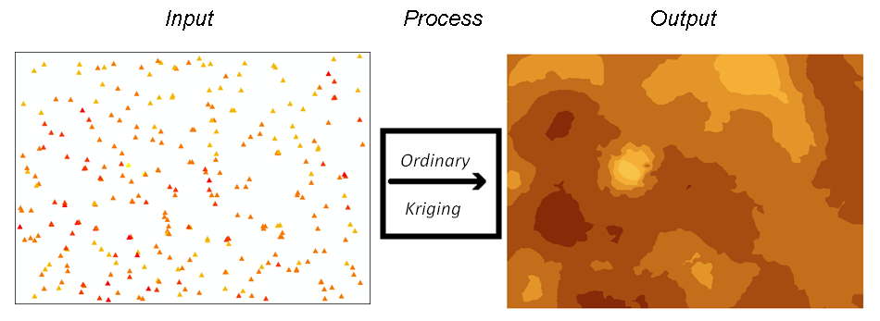
Motivating Example: Ordinary Kriging
Imagine we have data on the concentration of gold (denote it by Y) in western Pennsylvania at a set of 200 sample locations (call them points p1…p200).
Since Y has a meaningful value at every point, our goal is to create a prediction surface for the entire region using these sample points
Notation: In this western PA region, Y(p) will denote the concentration level of gold at any point p.

Slide 52
Global and Local Structure
Without any a priori knowledge about the distribution of gold in Western PA, we have no theoretical reason to expect to find different concentrations of gold at different locations in that region.
I.e., theoretically, the expected value of gold concentration should not vary with latitude and longitude
In other words, we would expect that there is some general, average, value of gold concentration (called global structure) that is constant throughout the region (even though we assume it’s constant, we do not know what its value is)
Of course, when we look at the data, we see that there is some variability in the gold concentrations at different points. We can consider this to be a local deviation from the overall global structure, known as the local structure or residual or error term.
In other words, geostatisticians would decompose the value of gold Y(p) into the global structure μ(p) and local structure ε(p).
Y(p) = μ(p) + ε(p)

Slide 53
ε(p)
As per the First Law of Geography, the local structures ε(p) of nearby observations will often be correlated. That is, there is still some meaningful information (i.e., spatial dependencies) that can be extracted from the spatially dependent component of the residuals.
So, our ordinary kriging model will:
Estimate this constant but unknown global structure μ(p), and
Incorporate the dependencies among the residuals ε(p). Doing so will enable us to create a continuous surface of gold concentration in western PA.

Slide 54
Assumptions of Ordinary Kriging
For the sake of the methods that we will be employing, we need to make some assumptions:
Y(p) should be normally distributed
The global structure μ(p) is constant and unknown (as in the gold example)
Covariance between values of ε depends only on distance between the points,
To put it more formally, for each distance h and each pair of locations p and t within the region of interest that are h units are apart, there exists a common covariance value, C(h), such that covariance [ε(p), ε(t)] = C(h).
This is called isotropy

Slide 55
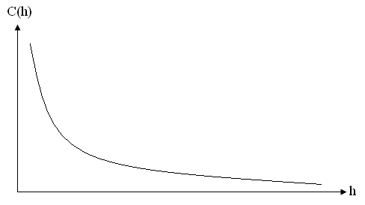
Covariance and Distance
From the First Law of Geography it would then follow that as distance between points increases, the similarity (i.e., covariance or correlation) between the values at these points decreases
If we plot this out, with inter-point distance h on the x-axis, and covariance C(h) on the y-axis, we get a graph that looks something like the one below. This representation of covariance as a function of distance is called as the covariogram
Alternatively, we can plot correlation against distance (the correlogram)

Slide 56
Covariograms and Weights
Geostatistical methods incorporate this covariance-distance relationship into the interpolation models
More specifically, this information is used to calculate the weights
As IDW, kriging is a weighted average of points in the vicinity
Recall that in IDW, in order to predict the value at an unknown point, we assume that nearer points will have higher weights (i.e., weights are determined based on distance)
In geostatistical techniques, we calculate the distances between the unknown point at which we want to make a prediction and the measured points nearby, and use the value of the covariogram for those distances to calculate the weight of each of these surrounding measured points.
I.e., the weight of a point h units away will depend on the value of C(h)

Slide 57
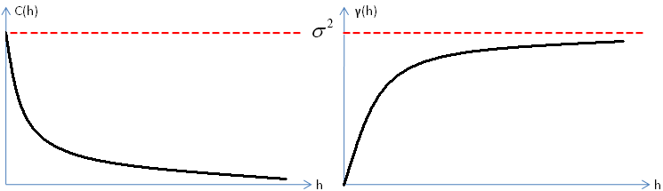
But…
Unfortunately, it so happens that one generally cannot estimate covariograms and correlograms directly
For that purpose, a related function of distance (h) called the semi-variogram (or simply the variogram) is calculated
The variogram is denoted by γ(h)
One can easily obtain the covariogram from the variogram (but not the other way around)
Covariograms and variograms tell us the spatial structure of the data
Covariogram C(h) Variogram γ(h)

Slide 58
Interpretation of Variograms
As mentioned earlier, a covariogram might be thought of as covariance (i.e., similarity) between point values as a function of distance, such that C(h) is greater at smaller distances
A variogram, on the other hand, might be thought of as “dissimilarity between point values as a function of distance”, such that the dissimilarity is greater for points that are farther apart
Variograms are usually interpreted in terms of the corresponding covariograms or correlograms
A common mistake when interpreting variograms is to say that variance increases with distance.
Covariogram C(h) Variogram γ(h)

Slide 59

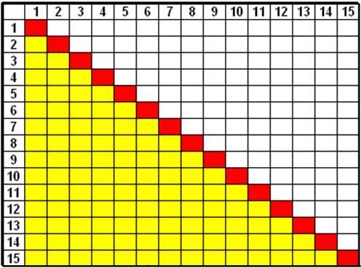
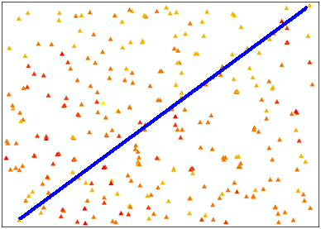
Bandwidth (The Maximum Value of h)
When there are n points, the number of inter-point distances is equal to
Example:
With 15 points, we have 15(15-1)/2 = 105 inter-point distances (marked in yellow on the grid in the lower left)
Since we’re using Euclidean distance, the distance between points 1 and 2 is the same as the distance between points 2 and 1, so we count it only once. Also, the distance between a point and itself will always be zero, and is of no interest here.
The maximum distance h on a covariogram or variogram is called the bandwidth, and should equal half the maximum inter-point distance.
In the figure on the lower right, the blue line connects the points that are the farthest away from each other. The bandwidth in this example would then equal to half the length of the blue line
h

Slide 60
Mathematical definition of a variogram
In other words, for each distance h between 0 and the bandwidth
Find all pairs of points i and j that are separated by that distance h
For each such point pair, subtract the value of Y at point j from the value of Y at point i, and square the difference
Average these square distances across all point pairs and divide the average by 2. That’s your variogram value!
Division by 2 -> hence the occasionally used name semi-variogram
However, in practice, there will generally be only one pair of points that are exactly h units apart, unless we’re dealing with regularly spaced samples. Therefore, we create “bins”, or distance ranges, into which we place point pairs with similar distances, and estimate γ only for midpoints of these bins rather than at all individual distances.
These bins are generally of the same size
It’s a rule of thumb to have at least 30 point pairs per bin
We call these estimates of γ(h) at the bin midpoints the empirical variogram

Slide 61
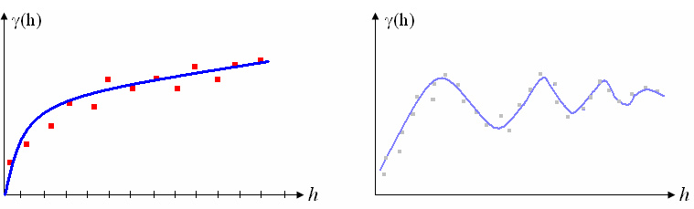
Fitting a Variogram Model
Now, we’re going to fit a variogram model (i.e., curve) to the empirical variogram
That is, based on the shape of the empirical variogram, different variogram curves might be fit
The curve fitting generally employs the method of least squares – the same method that’s used in regression analysis
A very comprehensive guide on variography by Dr. Tony Smith (University of Pennsylvania) http://www.seas.upenn.edu/~ese502/NOTEBOOK/Part_II/4_Variograms.pdf

Slide 62
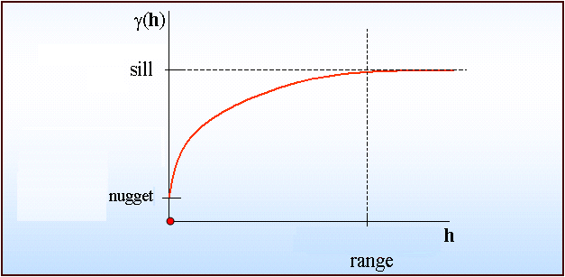
The Variogram Parameters
The variogram models are a function of three parameters, known as the range, the sill, and the nugget.
The range is typically the level of h at the correlation between point values is zero (i.e., there is no longer any spatial autocorrelation)
The value of γ at r is called the sill, and is generally denoted by s
The variance of the sample is used as an estimate of the sill
Different models have slightly different definitions of these parameters
The nugget deserves a slide of its own
Graph taken from: http://www.geog.ubc.ca/courses/geog570/talks_2001/Variogr1neu.gif

Slide 63
Reviewing Ordinary Kriging
Again, ordinary kriging will:
Give us an estimate of the constant but unknown global structure μ(p), and
Use variography to examine the dependencies among the residuals ε(p) and to create kriging weights.
We calculate the distances between the unknown point at which we want to make a prediction and the measured points that are nearby and use the value of the covariogram for those distances to calculate the weight of each of these surrounding measured points.
The end result is, of course, a continuous prediction surface
Prediction standard errors can also be obtained – this is a surface indicating the accuracy of prediction

Slide 64
Universal Kriging
Now, take another example: imagine we have data on the temperature at 100 different weather stations (call them w1..w100) throughout Florida, and we want to predict the values of temperature (T) at every point w in the entire state using these data.
Notation: temperature at point w is denoted by T(w)
We know that temperature at lower latitudes are expected to be higher. So, T(w) will be expected to vary with latitude
Ordinary kriging is not appropriate here, because it assumes that the global structure is the same everywhere. This is clearly not the case here.
A method called universal kriging allows for a non-constant global structure
We might model the global structure μ as in regression:
Everything else in universal kriging is pretty much the same as in ordinary kriging (e.g., variography)

Slide 65
Some More Advanced Techniques
Indicator Kriging is a geostatistical interpolation method does not require the data to be normally distributed.
Co-kriging is an interpolation technique that is used when there is a second variable that is strongly correlated with the variable from which we’re trying to create a surface, and which is sampled at the same set of locations as our variable of interest and at a number of additional locations.
For more details on indicator kriging and co-kriging, see one of the texts suggested at the end of this presentation

Slide 66
Isotropy vs. Anisotropy
When we use isotropic (or omnidirectional) covariograms, we assume that the covariance between the point values depends only on distance
Recall the covariance stationarity assumption
Anisotropic (or directional) covariograms are used when we have reason to believe that direction plays a role as well (i.e., covariance is a function of both distance and direction)
E.g., in some problems, accounting for direction is appropriate (e.g., when wind or water currents might be a factor)
For more on anisotropic variograms, see http://web.as.uky.edu/statistics/users/yzhen8/STA695/lec05.pdf

Slide 67
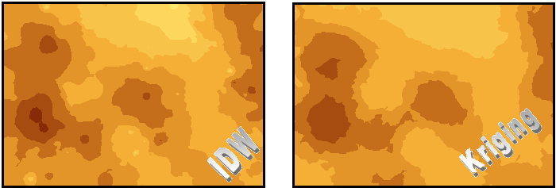
IDW vs. Kriging
We get a more “natural” look to the data with Kriging
You see the “bulls eye” effect in IDW but not (as much) in Kriging
Helps to compensate for the effects of data clustering, assigning individual points within a cluster less weight than isolated data points (or, treating clusters more like single points)
Kriging also give us a standard error
If the data locations are quite dense and uniformly distributed throughout the area of interest, we will get decent estimates regardless of which interpolation method we choose.
On the other hand, if the data locations fall in a few clusters and there are gaps in between these clusters, we will obtain pretty unreliable estimates regardless of whether we use IDW or Kriging.
These are interpolation results using the gold data in Western PA (IDW vs. Ordinary Kriging)

